Slide 1

BLACK FRIDAY SALES PREDICTION
TEAM NAME:
SOFTWARE CHASERS
BY
T.NAVEEN KUMAR
K.ANUSHA
N.KEERTHI REDDY
K.PAVITHRA
M.HARITHA

Slide 2

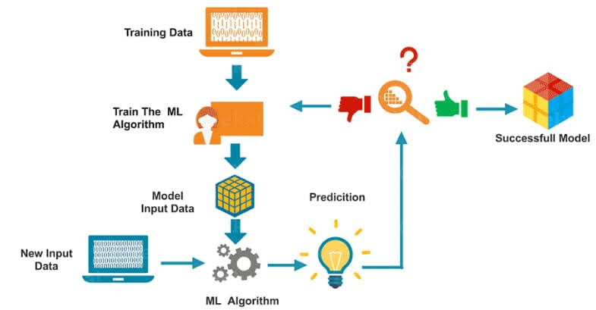
PYTHON AND MACHINE LEARNING
python
Machine learning
Guido Van Rossum
Interpreted , high level language
ML is a science to make a machine capable of making the decision itself

Slide 3

Project-BLACK FRIDAY SALES PREDICTION
Biggest shopping day
By considering the dataset
The age and stay in years are loop holes in the dataset

Slide 4
DATASET:
PURCHASE
PRODUCT CATEGORY
MARITAL STATUS
AGE
OCCUPATION
GENDER

Slide 5
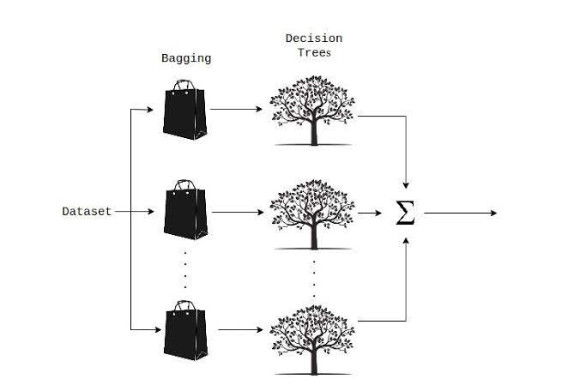
RANDOM FOREST REGRESSION
Random forest is an ensemble learning method for regression
It is a combination of decision trees

Slide 6
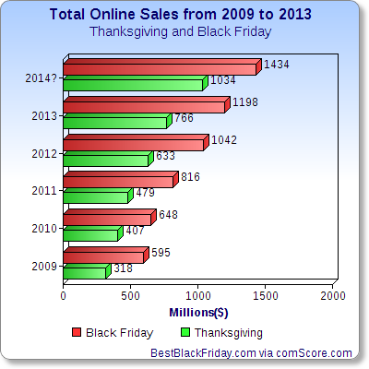
Sales on black friday
We can predict the sales of next year
inventory management based on forecast
Retail stores use the historical data track the sales

Slide 7
CONCLUSION
Machine learning algorithm of random forest regression is the best way to predict the amount that a customer is likely to spend on black friday

Slide 8


